Slide 1
Mini-Games
Group No.4

Slide 2
Leader: 17011581 Kim SunCheol
Team members:
17011573 Lee WonJin
21011697 Jeong Won
15010928 Sim Hyeong Seob
19012735 TUHTABOEV SHERZODBEK
19012777 ZAMONALIEV RAHMONALI

Slide 3
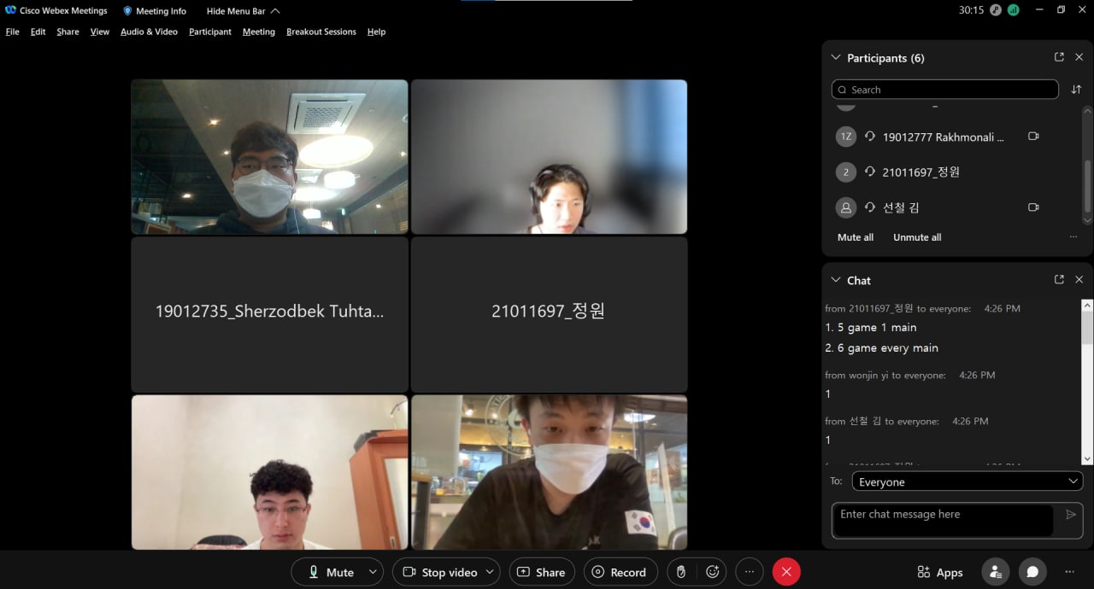

Slide 4
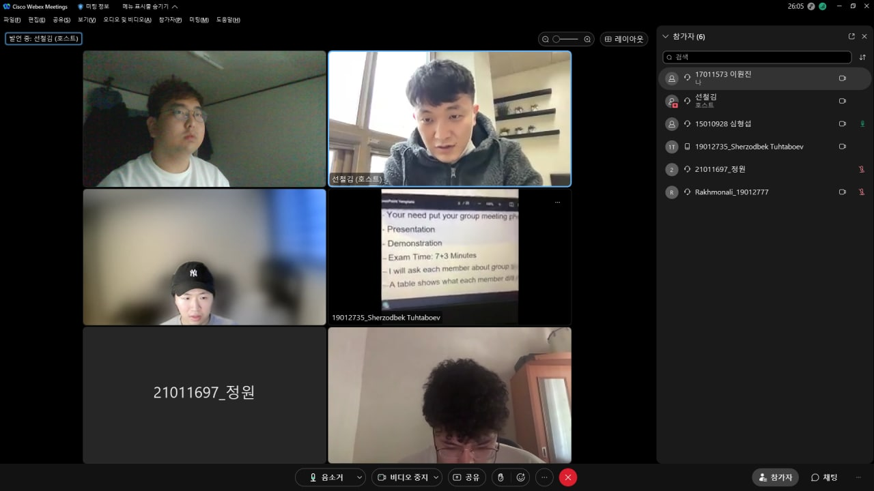

Slide 5
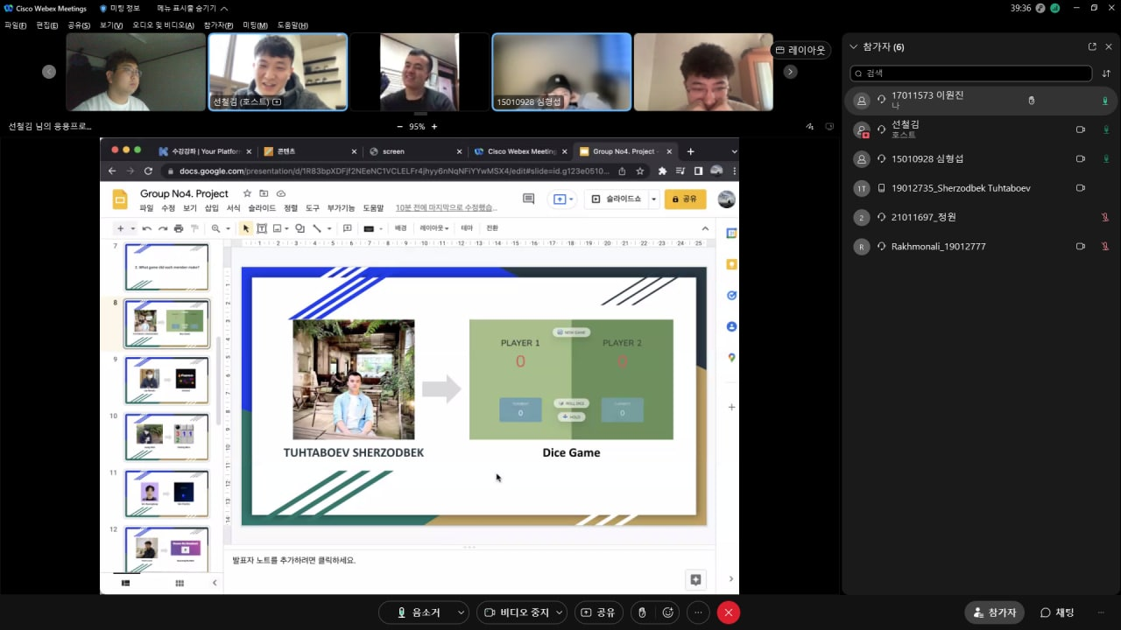

Slide 6


Slide 7
Index
1. What’s Group project topic?
2. Why did we choose this topic?
3. Role
4. What language and Tool did we use?
5. Demonstration

Slide 8
1. What’s Group project topic?
Mini Game Website

Slide 9
2. Why did we choose this topic?
Game is a topic that includes not only design but also programming.
Notes:
we thought we could show what we had learned in a variety of ways

Slide 10
3. Role

Slide 11
Name | Role
KIM SUN CHEOL | Team leader Making main site
JEONG WON | Making Finding Mine
LEE WON JIN | Making FireVoid
SIM HYEONG SEOB | Making Aim Practice
TUHTABOEV SHERZODBEK | Making Dice Game
ZAMONALIEV RAHMONALI | Making Guessing Number He suggested the topic ‘mini game website’

Slide 12
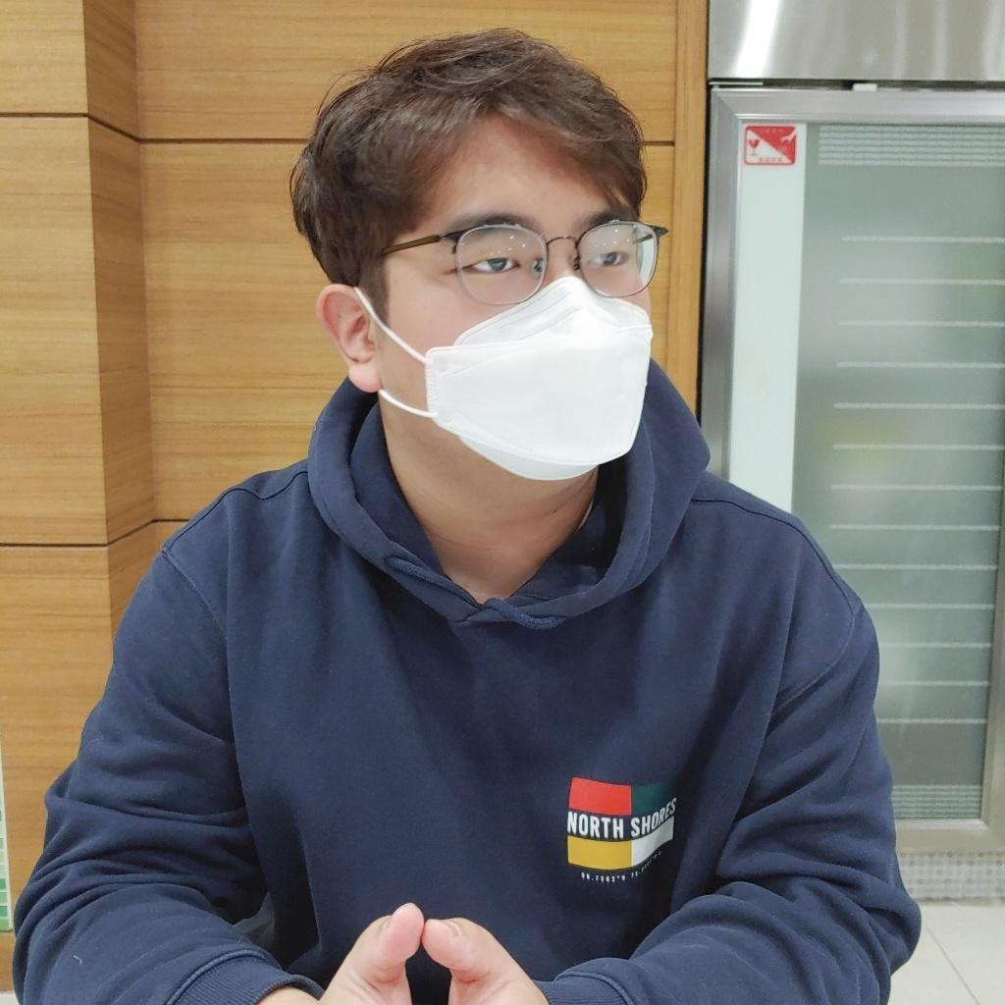

Lee WonJin
FireVoid

Slide 13
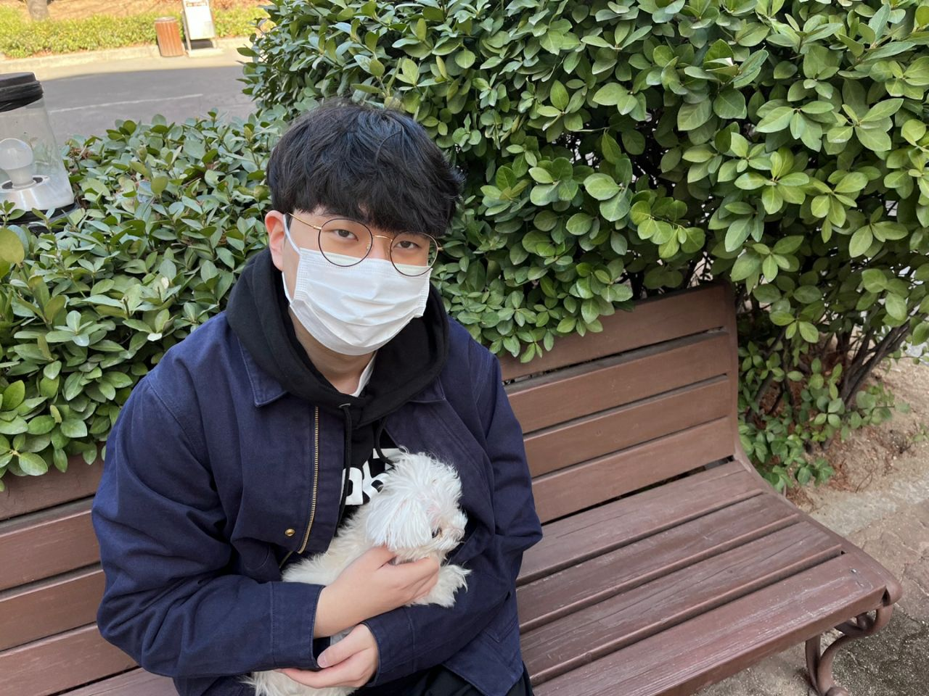
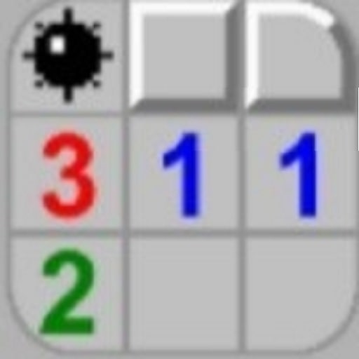
Jeong Won
Finding Mine

Slide 14


Sim HyeongSeop
Aim Practice

Slide 15
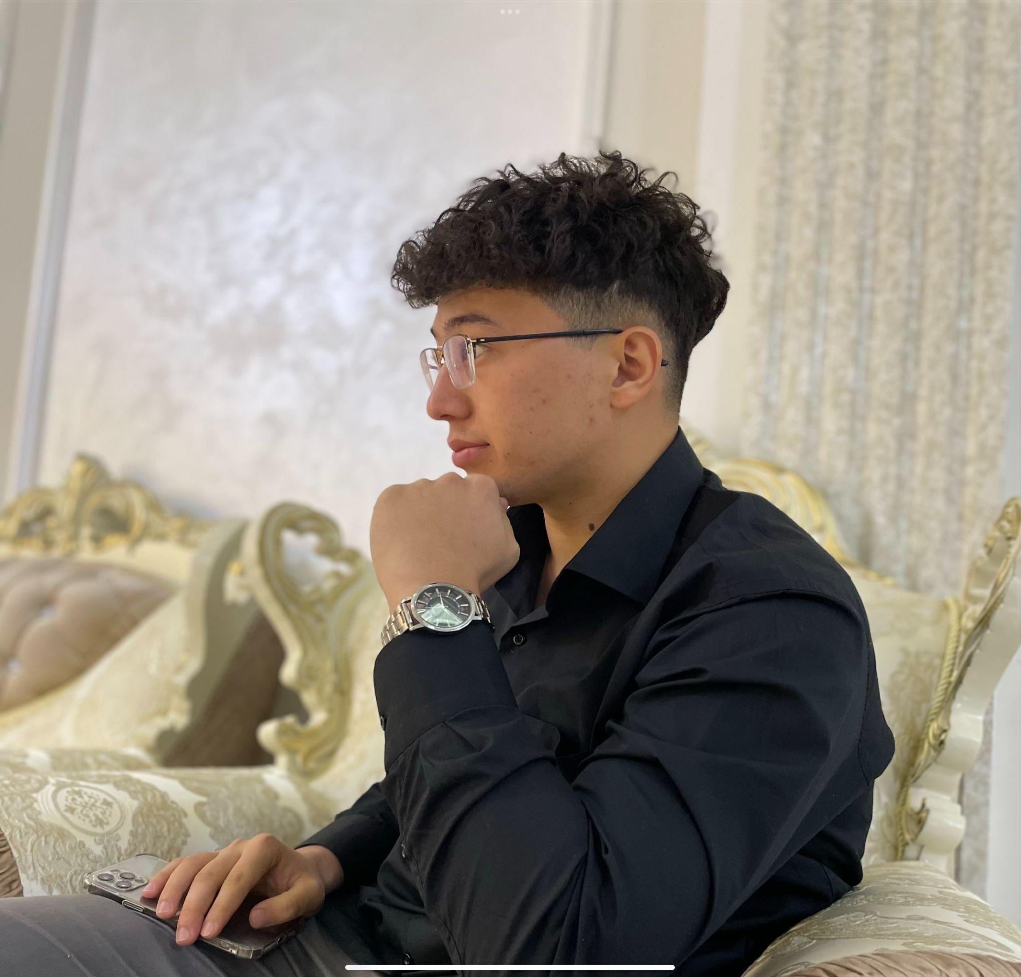

Rahmonali
Guessing Number

Slide 16
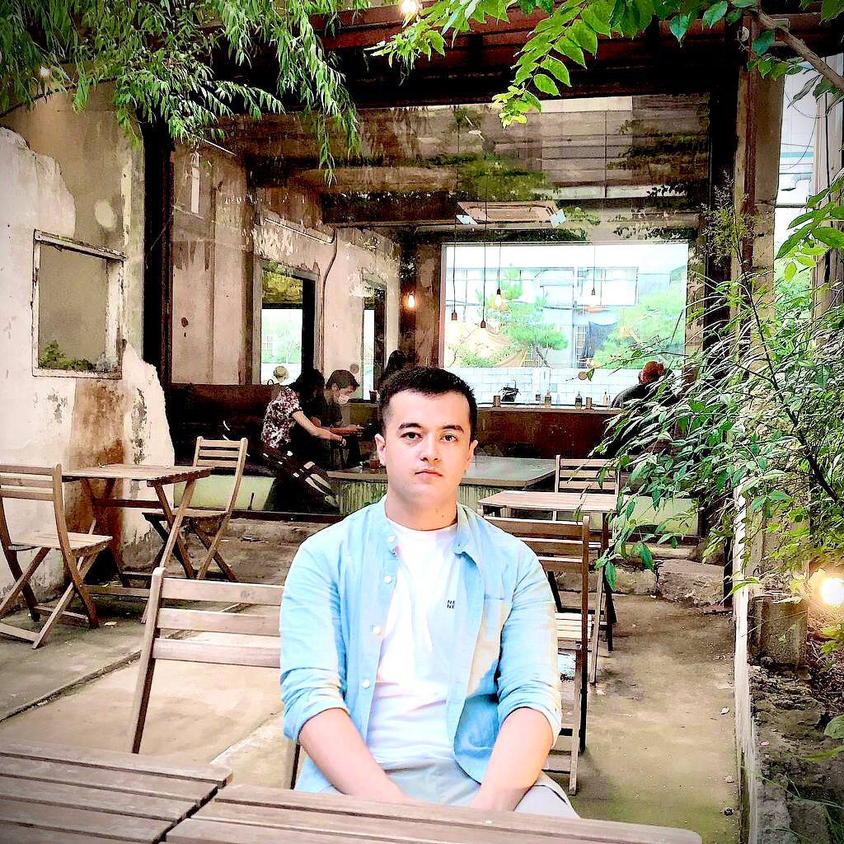
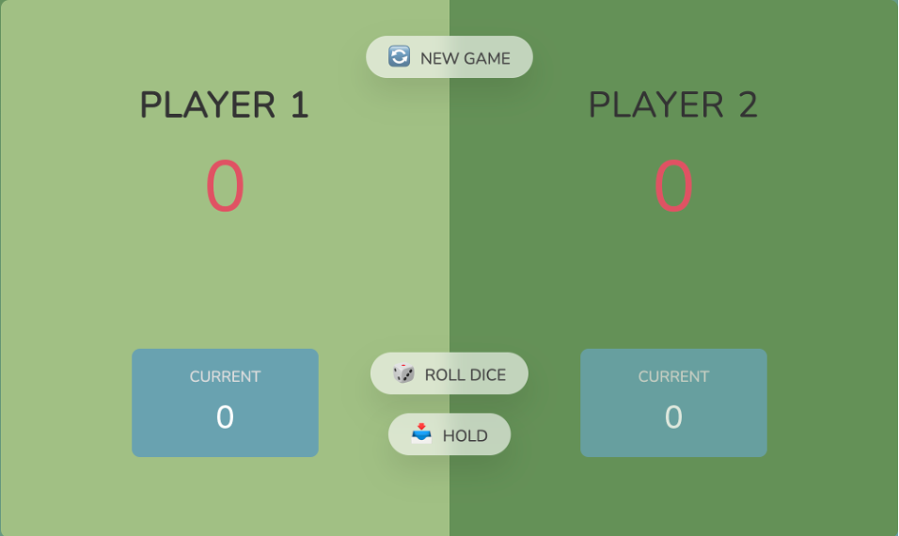
TUHTABOEV SHERZODBEK
Dice Game

Slide 17
4. What programming language
and Tool did we use

Slide 18


Slide 19

Visual Studio Code

Slide 20
5. Demonstration

Slide 21

Click this link to access the main site.
https://cheonjae6.github.io/Mini-Game/

Slide 22
Firevoid - 1. What is it
There are two people on either side.
The fire comes from both sides.
People should avoid fire.

Slide 23
Firevoid - 2. Rule
Component
There are 3 lanes.
There are 2 people . Each people can move to another lane.
Fire moves horizontally. Fire is generated at a random time and at a random lane.
Behavior : Each people can move to another lane. By keyboard input.
Game over : Game over When fire and men collide,

Slide 24
Firevoid - 3. Example
Avoid - Success
continue
(keep playing)

Slide 25
Firevoid - 3. Example
2. Avoid - Fail
Game
Over

Slide 26
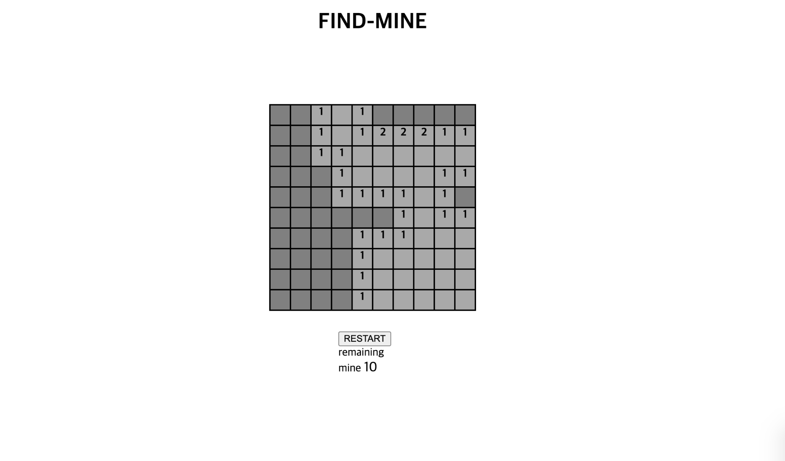
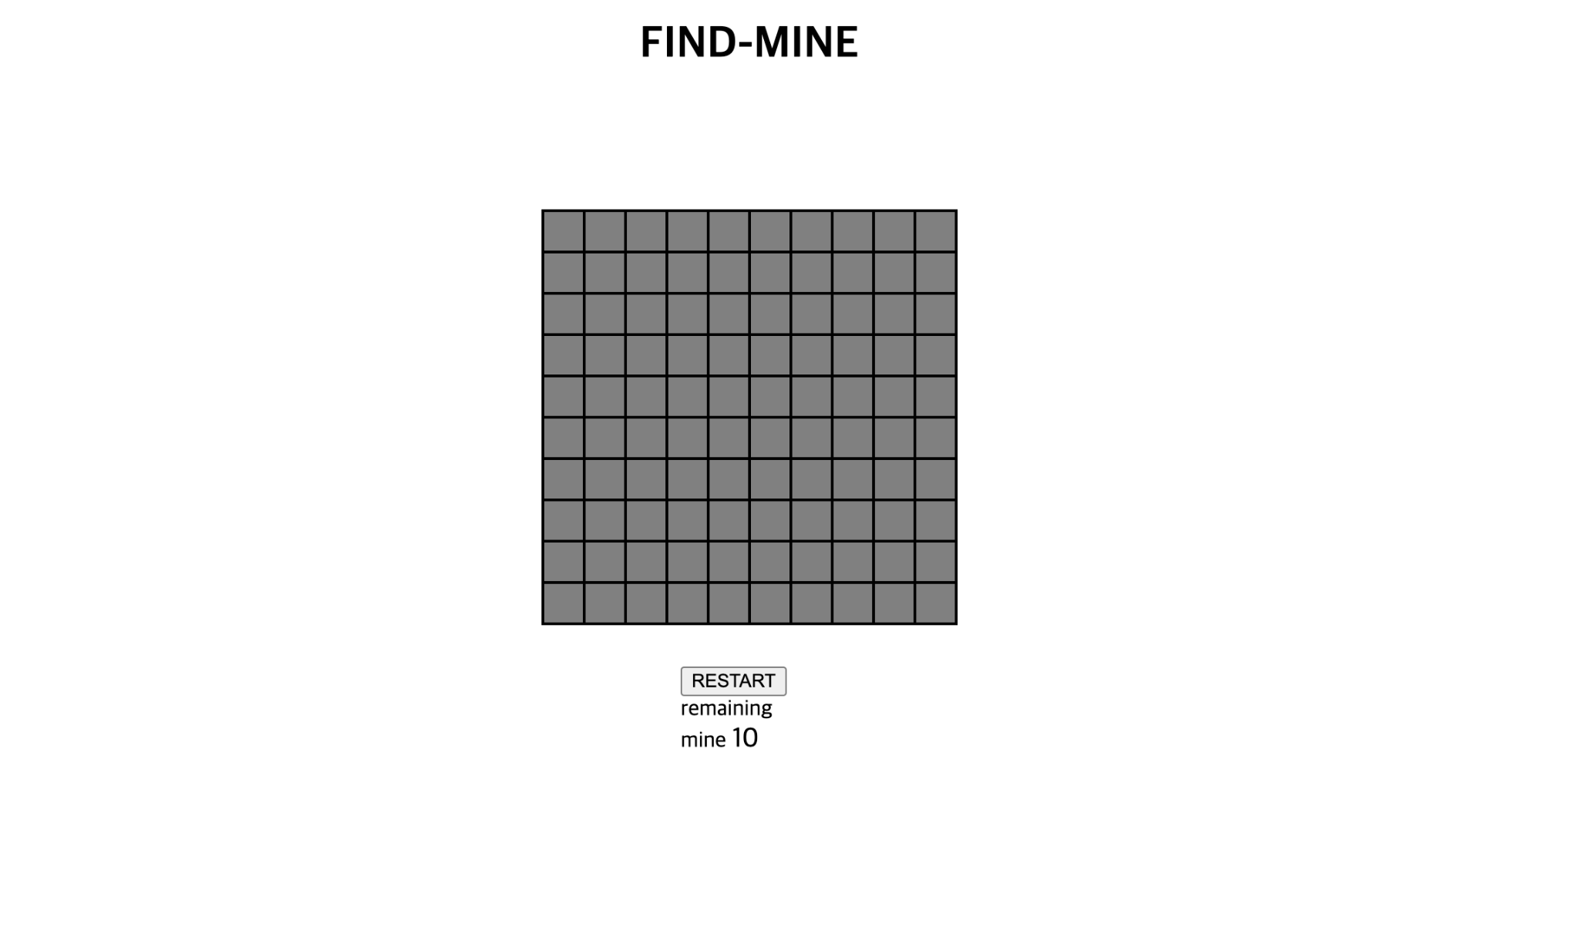
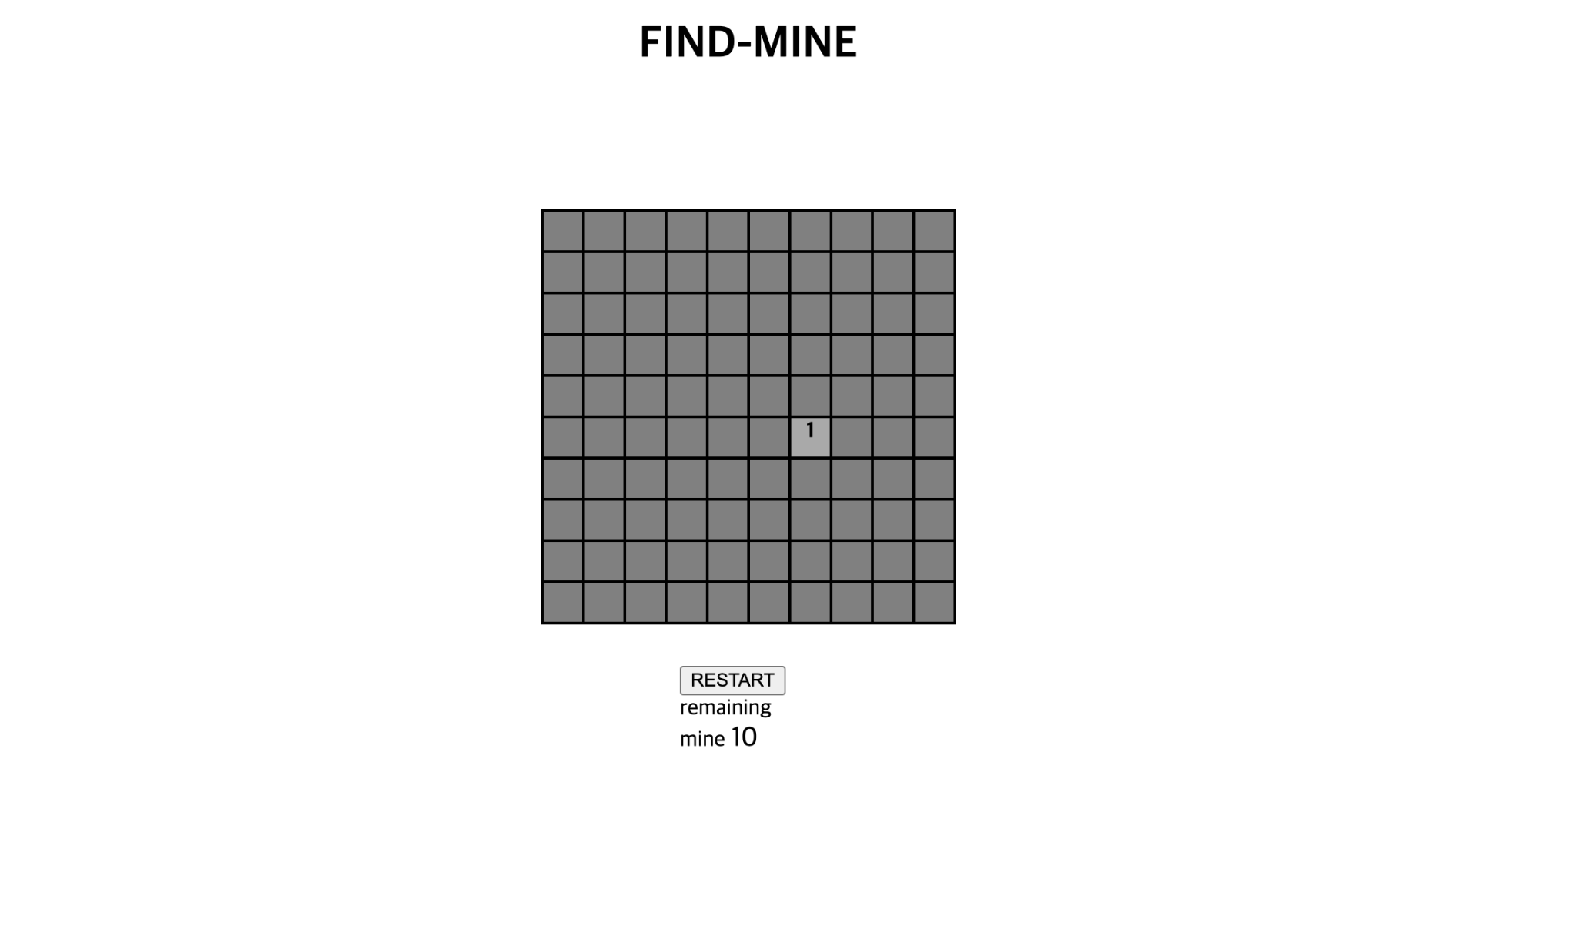
If you click here
If you click here

Slide 27
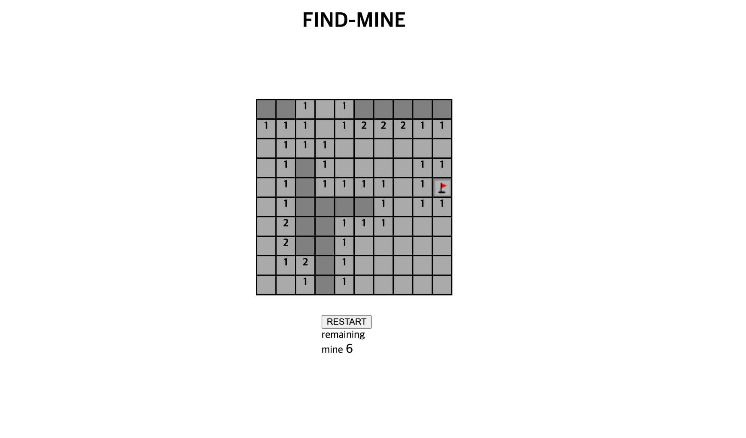
If you think there's a mine here, you can put a flag there.

Slide 28
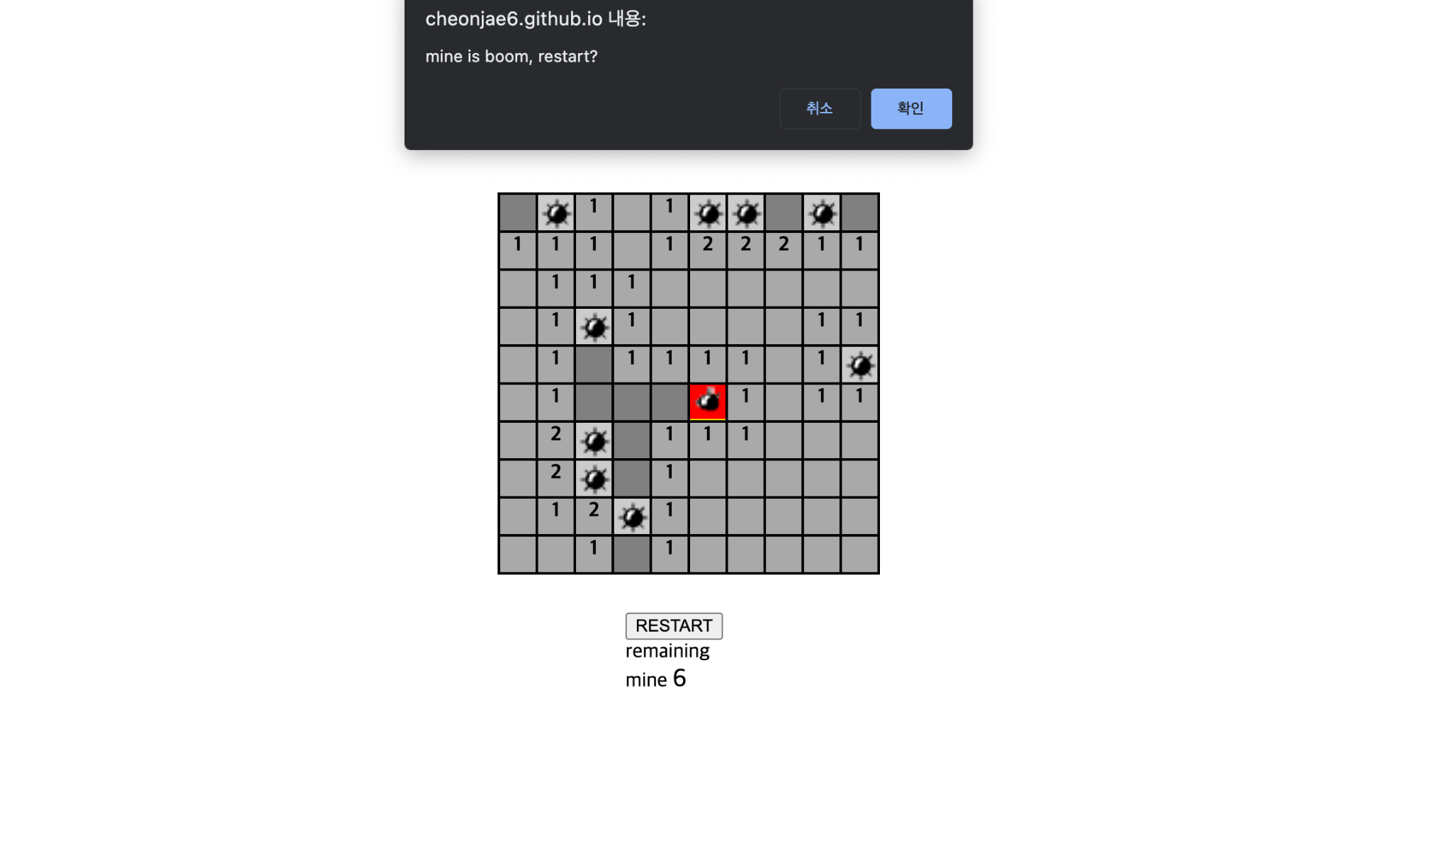
If you click here

Slide 29
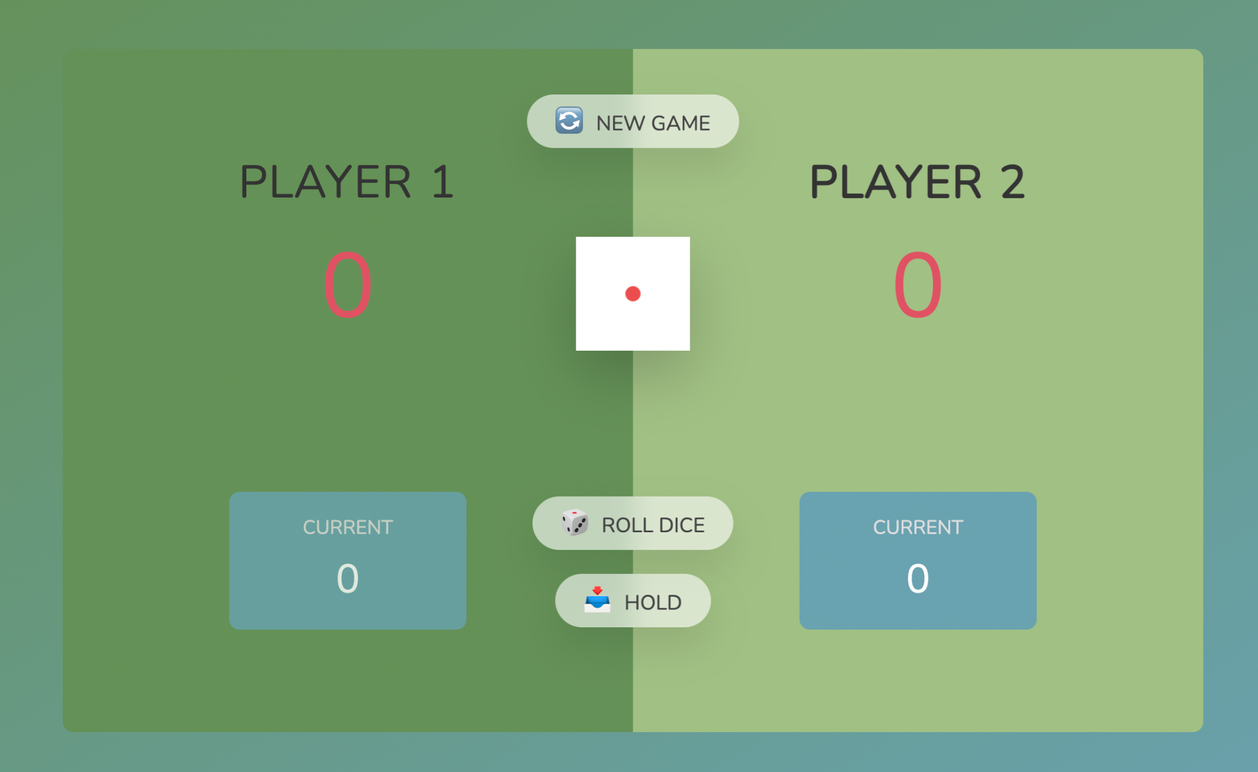
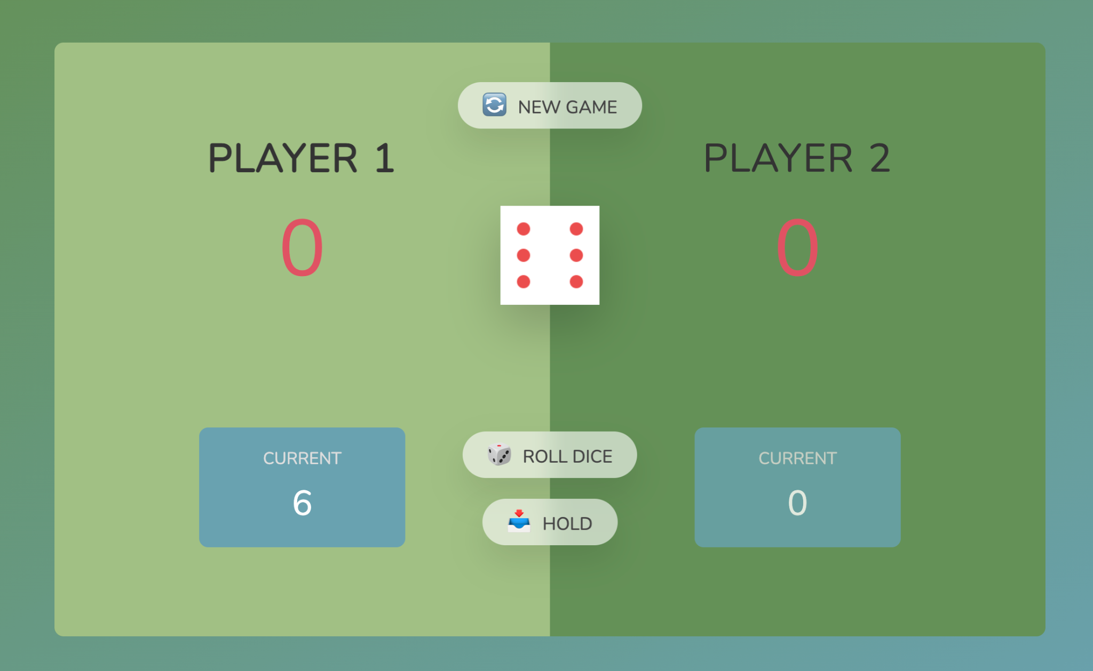
If you click this

Slide 30


If you click this

Slide 31


When you roll the dice

Slide 32

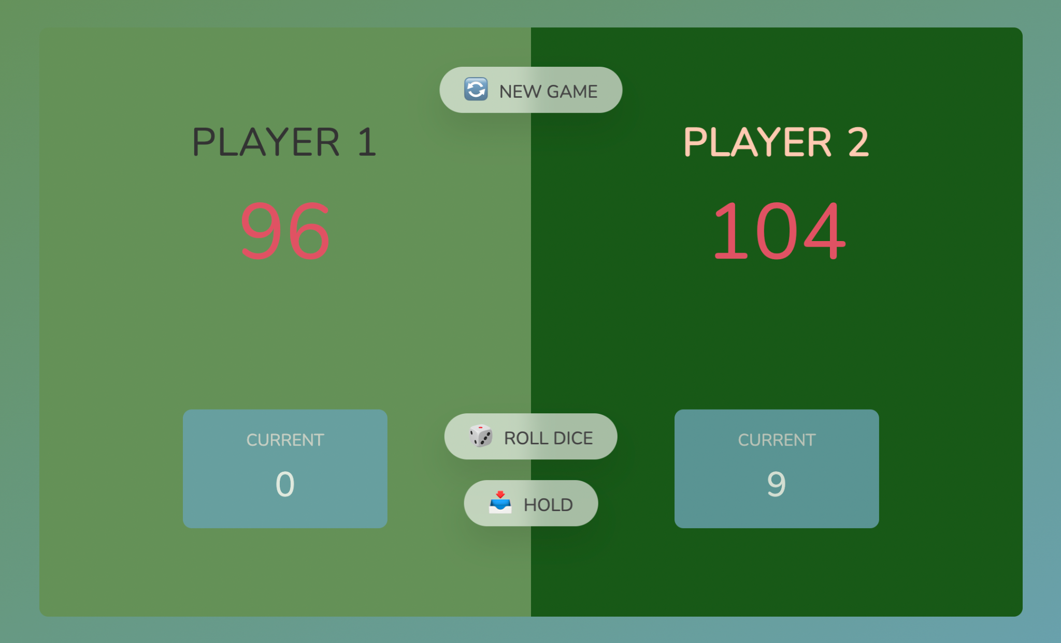
If PLAYER2 presses the Hold button

Slide 33
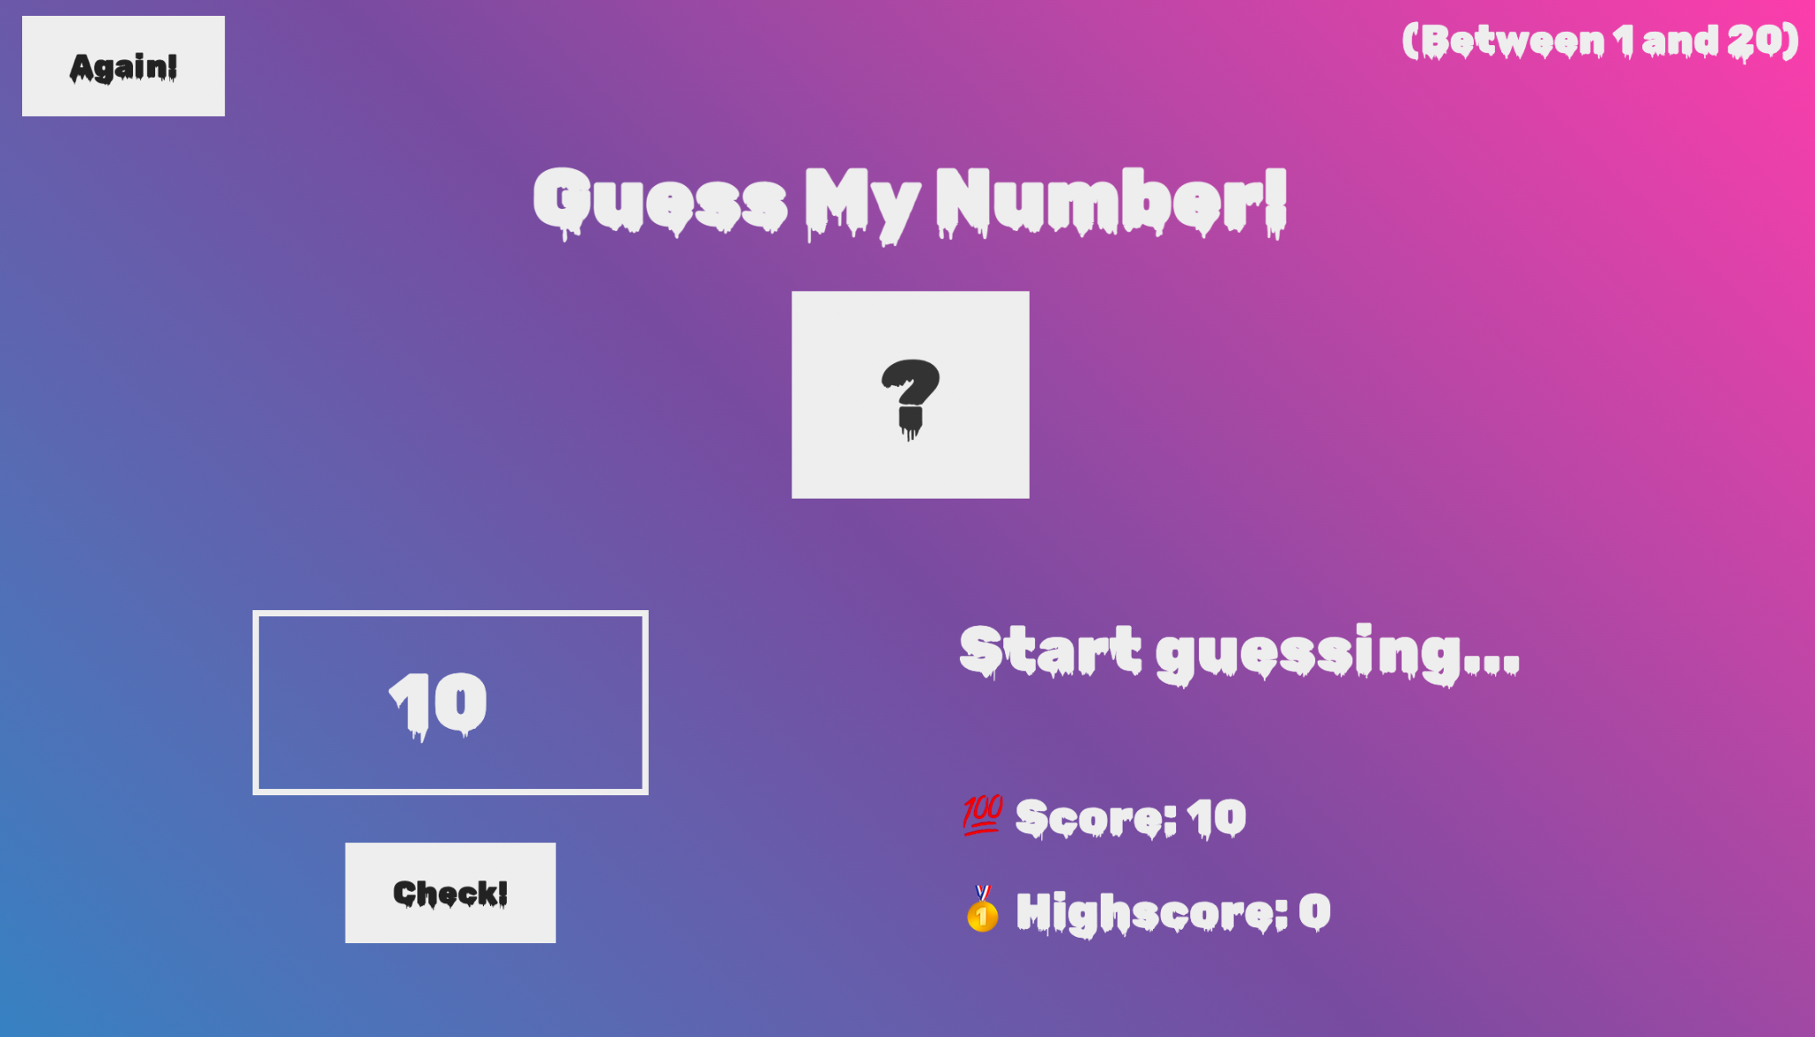
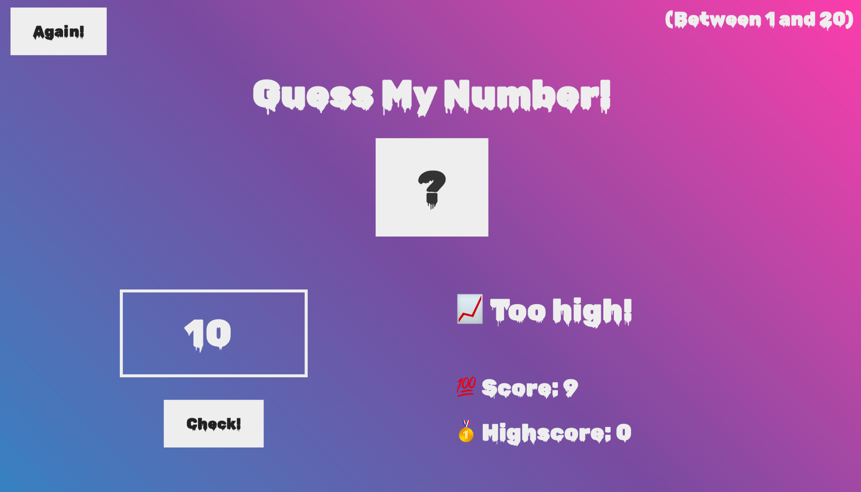
If you click this

Slide 34
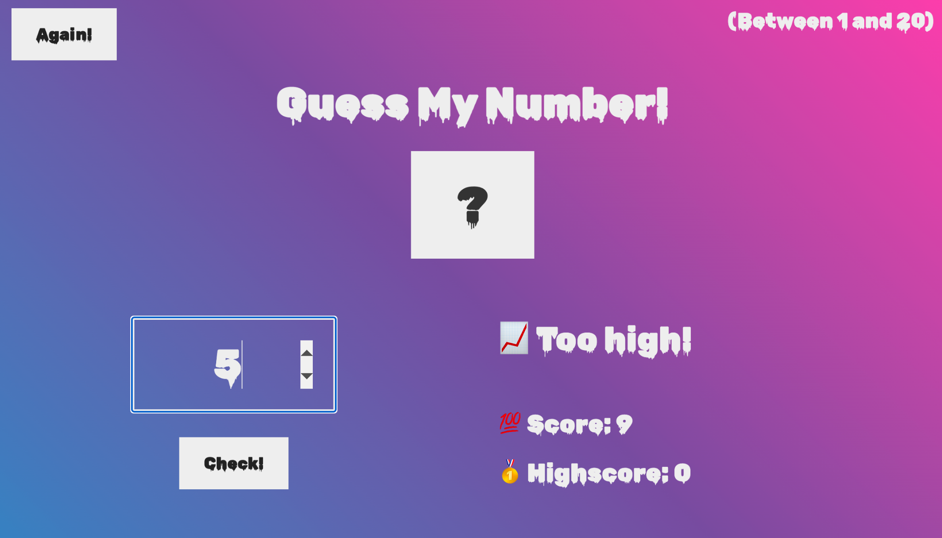

If you click this

Slide 35


If you click this

Slide 36
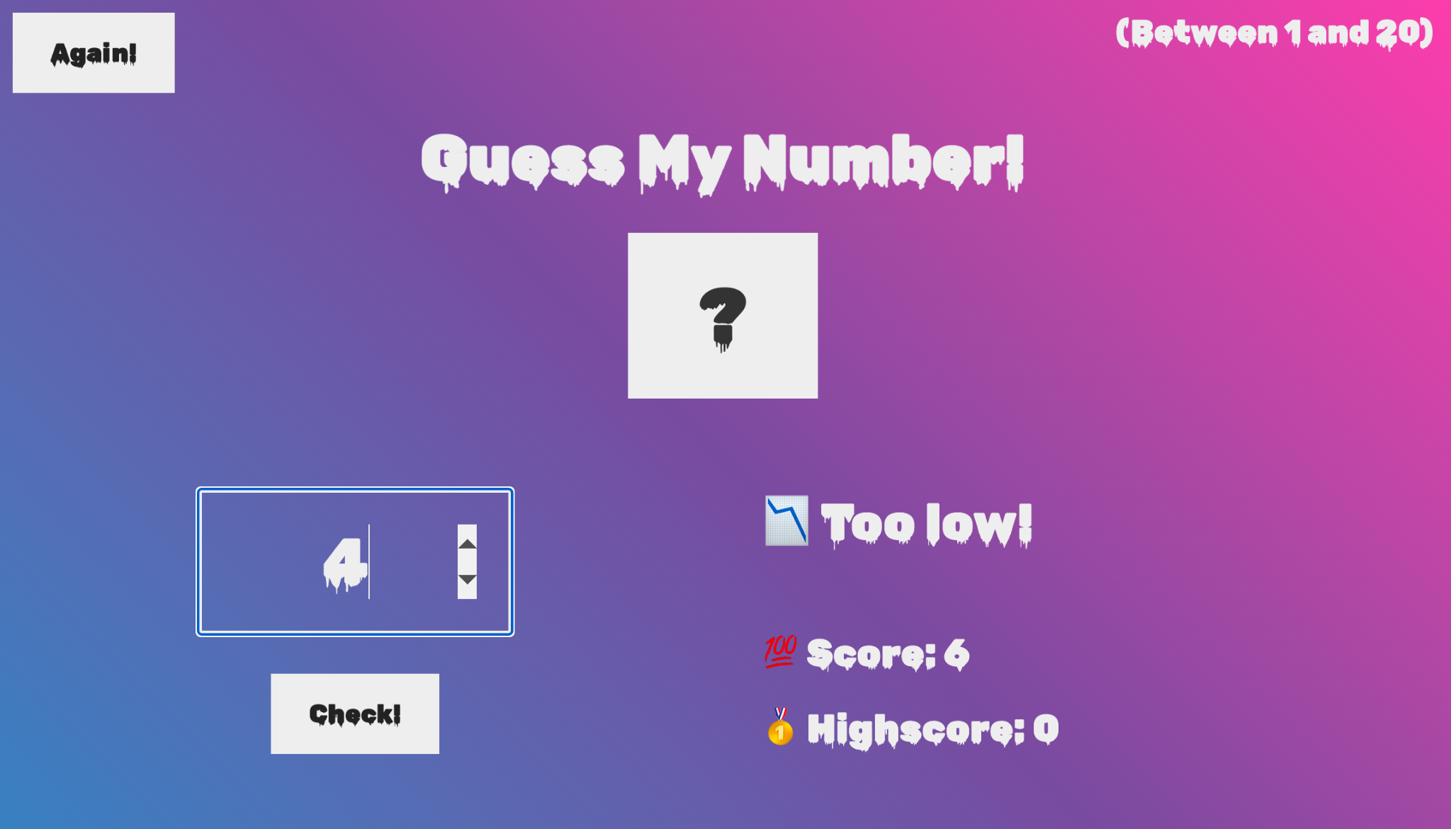
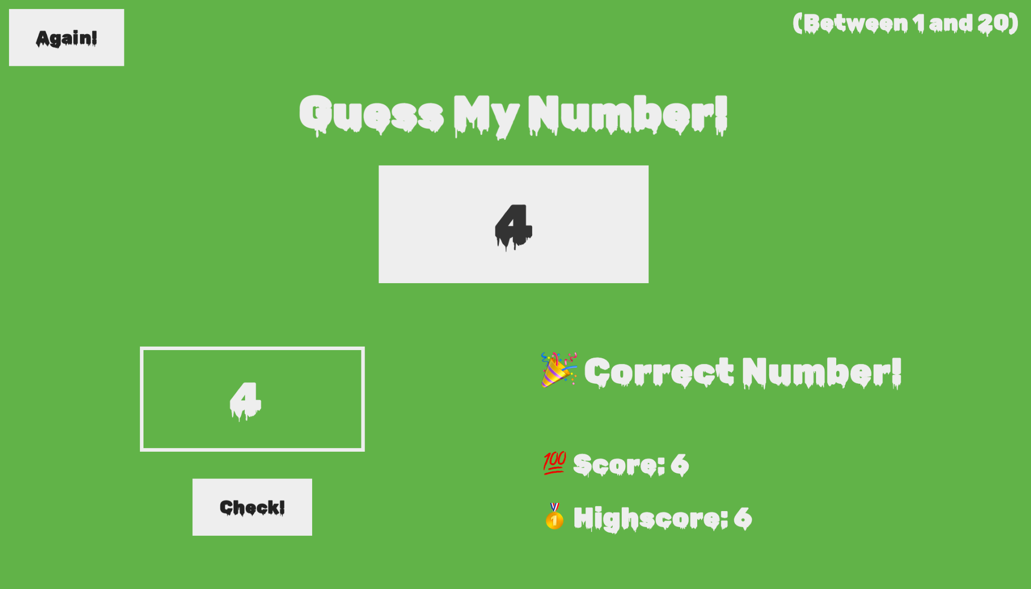
If you click this

Slide 37
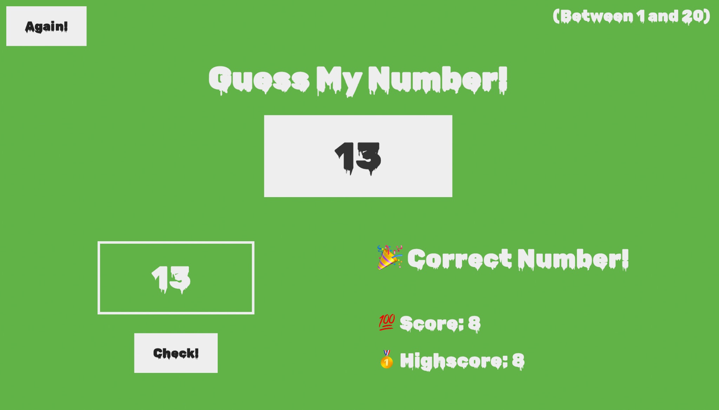


Slide 38
If you click this

Slide 39
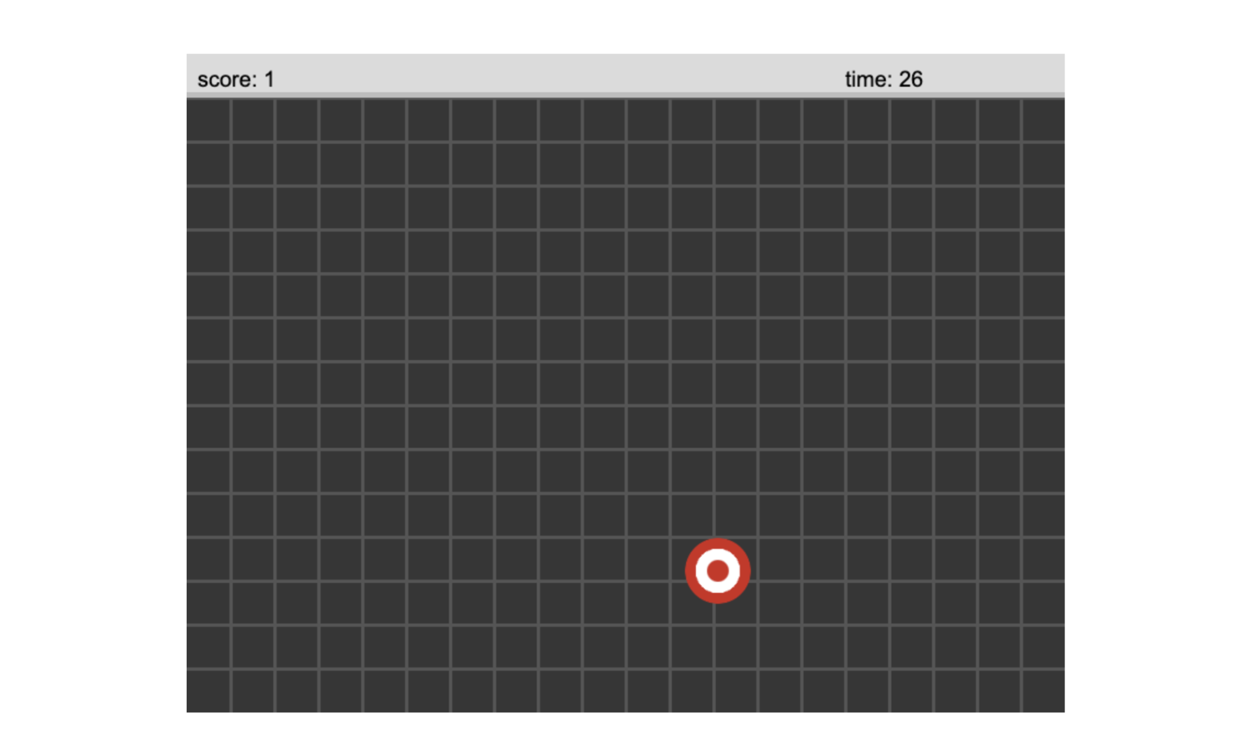
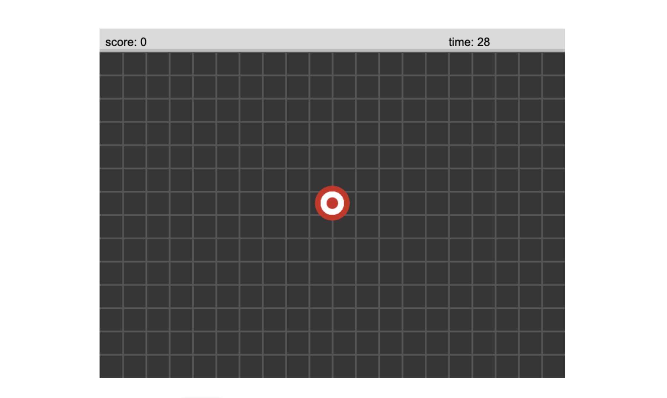
If you click this

Slide 40
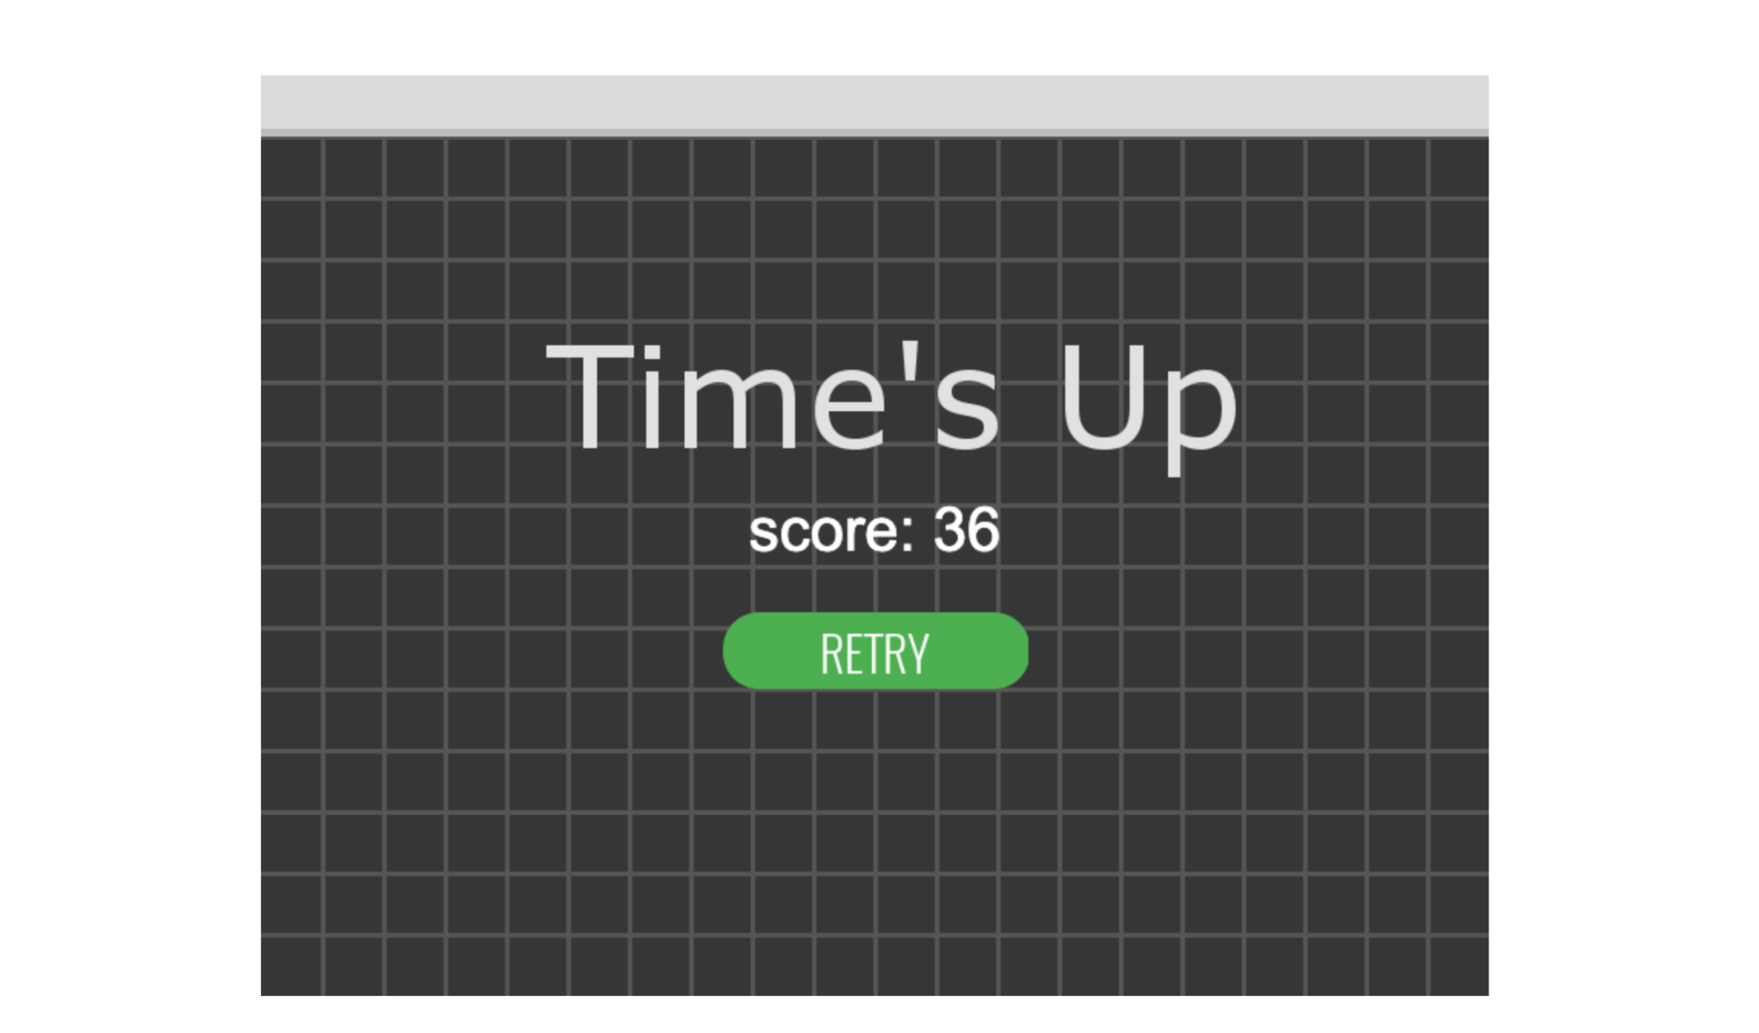

Slide 41


